Slide 1

Sheltered Instruction:
Writing Content and Language Objectives WS# 67950
Karina E. Chapa, M.Ed.
Language Proficiency, Biliteracy and Cultural Diversity Director
kchapa@esc1.net
Twitter @esc1bilingual @bilingualpride

Slide 2

Professional Learning Essential Agreements
Be respectful of others
Be an active participant
Take care of your needs
Use electronic devices as learning tools
©2017 Region One Education Service Center

Slide 3
Agenda
ELPS
Content and Language Objectives
Sheltered Instruction
©2017 Region One Education Service Center

Slide 4
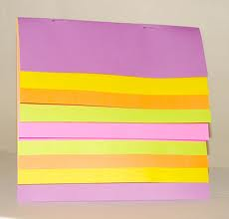
Keeping It Together
Sheltered Instruction

Slide 5
ELPS
English Language Proficiency Standards

Slide 6
Session Objectives
Content Objective
Today I will examine how to implement the ELPS in all content areas and how to analyze TELPAS data to guide instruction.
Language Objective
Today I will share (orally and in writing) different ideas on how to linguistically accommodate instruction for ELLs.

Slide 7

ELPS
Anticipation Guide
kahoot.it
create.kahoot.it

Slide 8
Statutory Requirement
19 Texas Administrative Code 74.4 Chapter 74. Curriculum Requirements Subchapter A. Required Curriculum 74.4 English Language Proficiency Standards
Adopted December 2007

Slide 9


ELPS Resources
LIAG and ELPS Instructional Tool

Slide 10
ELPS: How are they organized?
Big Ideas
1. Make Content Comprehensible
2. Develop Academic Language
Big Responsibilities
1. Communicated
2. Sequenced
3. Scaffolded
Student Expectations
1. Listening
2. Speaking
3. Reading
4. Writing
5. Learning Strategies
PLDs (L, S, R, W)
1. Beginning
2. Intermediate
3. Advanced
4. Advanced High
©2017 Region One Education Service Center

Slide 11
ELPS Mingle!
  Listening PLDs
  Listening Expectations & CCRS
  Listening Teacher Behaviors
  Speaking PLDs
  Speaking Expectations & CCRS
  Speaking Teacher Behaviors
  Reading 2-12 PLDs
  Reading Expectations & CCRS
  Reading Teacher Behaviors
  Writing 2-12 PLDs
  Writing Expectations & CCRS
  Writing Teacher Behaviors

Slide 12
TEKS vs ELPS
STAAR
TELPAS
T
E
K
S
E
L
P
S

Slide 13
TEKS vs ELPS
Academic Proficiency Language Proficiency
STAAR
TELPAS
TEKS
ELPS
Relating Factor: evaluates/measures

Slide 14
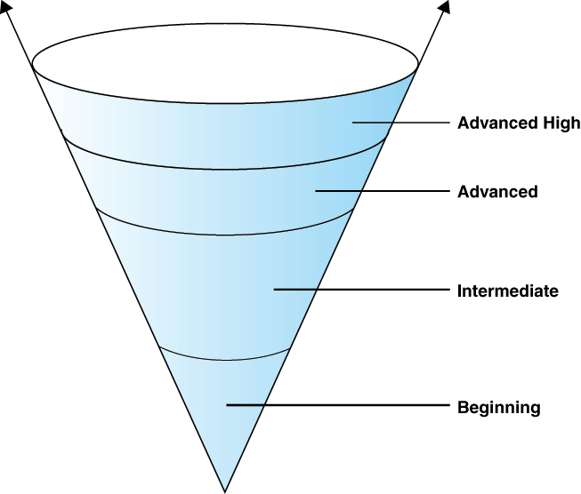
TELPAS Levels

Slide 15
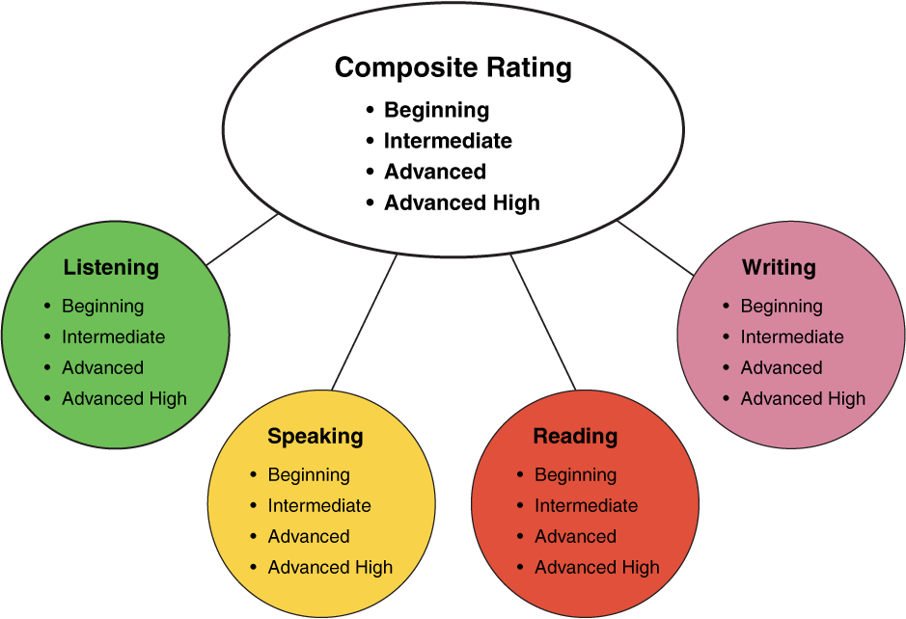
TELPAS Domains
10%
30%
10%
50%

Slide 16
DMAC TELPAS Reports
How to Run TELPAS Reports by Language Domain
Go to Home Page
Go to State Assessment
Select TELPAS
Select Instructional Reports
Select Student Language Proficiency Rating
Generate Report

Slide 17

Sample DMAC Report

Slide 18
Keeping It Together
Sheltered Instruction
ELPS

Slide 19
The power of Cognates

Slide 20
The Power of Cognates
La chimica è la scienza che studia la composizione della materia ed il suo comportamento in base a tale composizione.

Slide 21
The Power of Cognates
La chimica è la scienza che studia la composizione della materia ed il suo comportamento in base a tale composizione.

Slide 22

Your Turn!
1. Individually make a list of 5 academic words from any content area.
2. Turn to your partner and combine your two lists of words (even if from different content areas).
3. Find another pair and exchange your lists.
4. Write the Spanish cognates next to each academic word. Use Google Translate if needed.
5. Calculate what percentage of the words are cognates.
1 – 2 – 4 – ALL
http://www.realfastspanish.com/vocabulary/spanish-cognates

Slide 23
Sheltered instruction
Strategies

Slide 24
Session Objectives
Content Objective
Language Objective
Today I will explore sheltered instruction techniques and strategies to make content comprehensible for my ELLs.
Today I will share different ideas on how to implement sheltered instruction strategies in the classroom.

Slide 25
Three-Step Interview
Stand up when you can complete one of these sentences:
  Teaching ELLs is so difficult because…
  One challenge I face when teaching ELLs is…
  One challenge I face when instructing ELLs is… What I have done to overcome this challenge is…
Beginner
Intermediate
Advanced

Slide 26
What are the two goals of Sheltered Instruction?
Make Content Comprehensible
Develop Academic Language

Slide 27
Content and language objectives

Slide 28
Anticipation Guide
kahoot.it
create.kahoot.it
Let’s Kahoot!

Slide 29
Round Table
Divide a piece of paper in two sections
Create a T chart
Write everything you know about content and language objectives
15 seconds!
Pass your paper to your right!
Repeat!
Content Objectives
Language Objectives
Let’s Write!

Slide 30
The What and the How
Content Objectives come from the TEKS
What am I going to learn?
Language Objectives come from the ELPS
How will I demonstrate my learning through listening, speaking, reading and/or writing?
Content and Language Objectives

Slide 31
Content Objective - Sample
Science TEKS: Differentiate between structure and function in plant and animal cell organelles including cell membrane, cell wall, nucleus, cytoplasm, mitochondria, chloroplast and vacuole.
STUDENT FRIENDLY CONTENT OBJECTIVE
Today I will compare and contrast the cell structures and functions of plants and animals.

Slide 32
Writing Content Objectives
Pair-up
Analyze a Student Expectation (TEKS) from any content area
Write it in a student-friendly format
You have 2 minutes
Write it on the top of a chart paper
Today I will…

Slide 33
Science TEKS: Differentiate between structure and function in plant and animal cell organelles including cell membrane, cell wall, nucleus, cytoplasm, mitochondria, chloroplast and vacuole.
CONTENT OBJECTIVE
Today I will compare and contrast the cell structures and functions of plants and animals.
LANGUAGE OBJECTIVE
©2017 Region One Education Service Center

Slide 34
Language Objective - Sample
Content Objective:
Today I will compare and contrast the cell structures and functions of plants and animals.
Language Objective:
Today I will write an essay comparing and contrasting plant and animal cells utilizing transitional phrases.

Slide 35
Writing Language Objectives
Pair-up
Look back at the content objective you wrote
Write a language objective in a student-friendly format
You have 2 minutes
Write it on the chart paper below the content objective
Today I will…

Slide 36
Science TEKS: Differentiate between structure and function in plant and animal cell organelles including cell membrane, cell wall, nucleus, cytoplasm, mitochondria, chloroplast and vacuole.
CONTENT OBJECTIVE
Today I will compare and contrast the cell structures and functions of plants and animals.
LANGUAGE OBJECTIVE
Today I will write an essay comparing and contrasting plant and animal cells utilizing transitional phrases.
©2017 Region One Education Service Center

Slide 37
Key Points to Remember
Make objectives student friendly and appropriate for grade level
Objectives are for students, not for the adults in the classroom
Post eye level
Review with students before, during and after each lesson

Slide 38
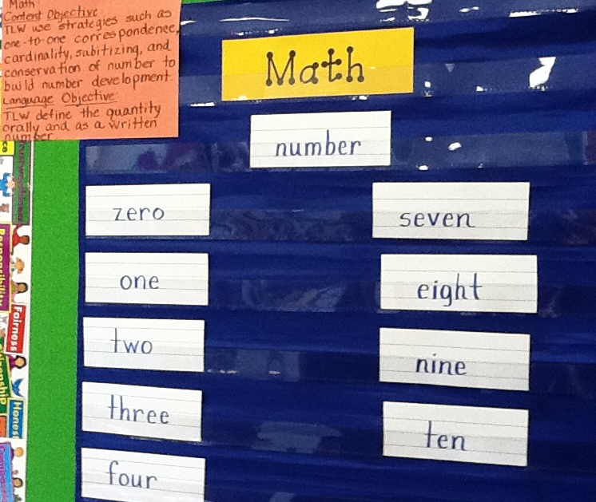
Provide Feedback
Content and Language Objectives

Slide 39
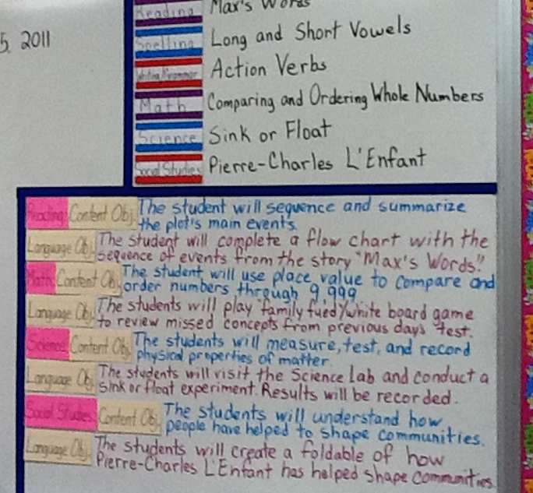
Provide Feedback
Content and Language Objectives

Slide 40
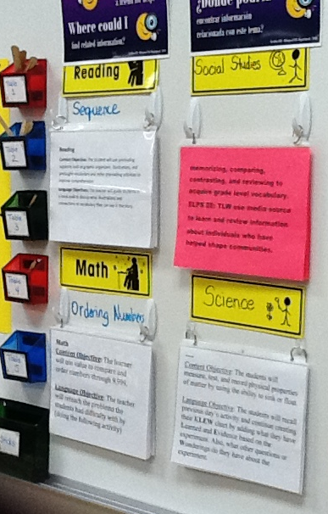
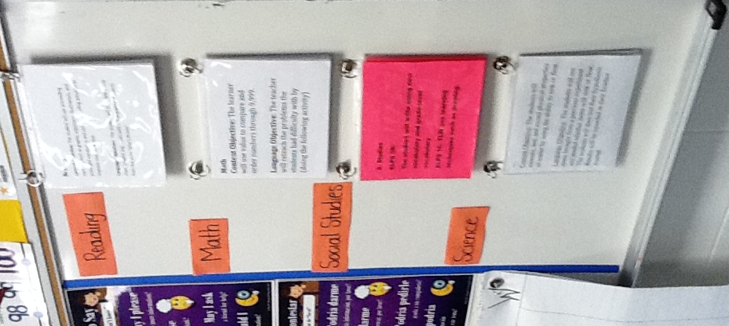
Provide Feedback

Slide 41
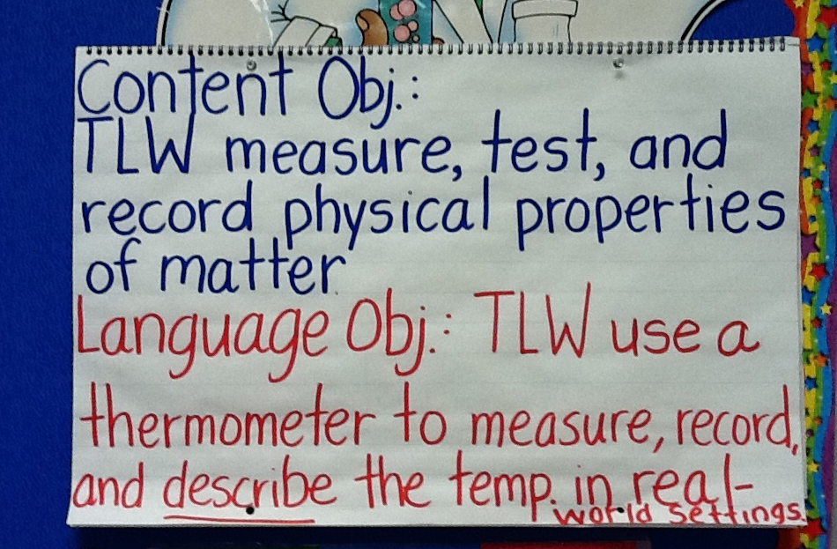
Provide Feedback

Slide 42
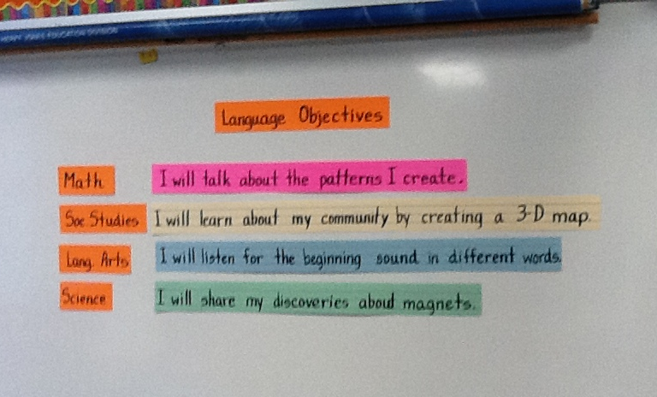
Provide Feedback

Slide 43
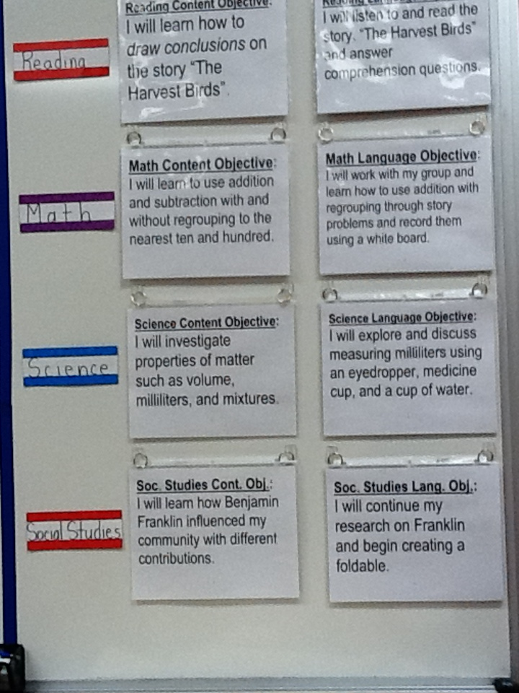
Provide Feedback
Content and Language Objectives

Slide 44
Keeping It Together
Sheltered Instruction
ELPS
Content and Language Objectives

Slide 45
Speaking in complete sentences

Slide 46
1-2-4-ALL
Why is it important to encourage English Learners to speak in complete sentences?
Write your individual answer on a piece of paper.
Share with a partner and add any new ideas to your paper.
Now share with another pair your answers and keep adding new ideas to your own papers.
As a whole table come up with a final complete answer.

Slide 47
Share Your Answers
iRandomizer App

Slide 48
Use of Complete Sentences
Does this mean that students need to answer in complete sentences all the time?
TIP:
Provide students with sentence frames and sentence starters if they are struggling to produce complete thoughts in English.

Slide 49
Use of Complete Sentences
  1. When reviewing a handout or worksheet
    Non-Example
    Teacher: How much is 5 X 4?
    Student: 20!
    Example
    Teacher: What is the product of 5 X 4?
    Student: The product of 5 and 4 is 20

Slide 50
Use of Complete Sentences
  2. When students are given sentence starters
    Non-Example
    Teacher: Who is your favorite character and why?
    Student: Esperanza!
    Example
    Teacher: Who is your favorite character and why? Please complete the following sentence: “My favorite character is… because…”
    Student: My favorite character is Esperanza, because she was very brave.

Slide 51
Your Turn! Gallery Walk!
Using the Content and Language Objectives that you developed, write 2 questions and 2 sentence stems that your students might be able to answer throughout the lesson.
Write them on post-its and place them on your chart paper.

Slide 52
Keeping It Together
Sheltered Instruction
ELPS
Content and Language Objectives
Speaking in Complete Sentences

Slide 53
RANDOMIZATION TECHNIQUES

Slide 54

Make an Appointment
©2017 Region One Education Service Center

Slide 55
Randomization Techniques
Write-Read-Read-Trade
Stand up when you complete in writing one of these sentences:
  I select who I call on by…
  In my classroom, I include randomization because…
  The most beneficial randomization technique I have used is… because…
  Find your 12 o’clock, share your answers and trade your papers.

Slide 56
Randomization Techniques
Is it possible to randomize and differentiate instruction at the same time?
Randomize and rotate who is called on,
so students of all language levels can participate!

Slide 57
Randomization Techniques
Lucky sticks
Beach ball
Index cards
with student names
Class list/roster
Color/numbers
Birthdays
Physical characteristics: longest hair, eye color…
Jenga
Pick up sticks
Career cards
Apps
Popcorn

Slide 58
Keeping It Together
Sheltered Instruction
ELPS
Content and Language Objectives
Speaking in Complete Sentences
Randomization Techniques

Slide 59
Total response signals

Slide 60
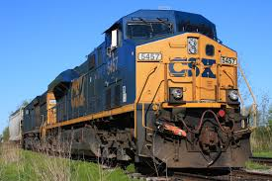
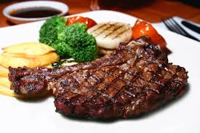
Why is it important to check for understanding along the way?

Slide 61
Written Responses
Hold up paper
White boards
Ready Responses
Hands up when ready
Personal Chalkboards
Answers on cards
Thinker’s chin
Stand up when ready
Put your pen on your paper when ready
All eyes on teacher
Making Choices
Open hand/closed hand
Ranking
Rank with your fingers
Thumbs/Pens up/down
Number wheels
Green card/red card
Move to the corner/spot
Rank with your arm
Line up according to response
Knocking/clapping/
cheering

Slide 62
Find the Fib!
Students may work in pairs or small groups.
Students have three post-its/index cards with the numbers “1, 2, 3” in each card.
Teacher writes 3 statements on the board (one false, two true) and students decide which one is the fib.
On signal from teacher, students show the number of the statement they believe is the fib.

Slide 63
Let’s Play!
Find the Fib
Evaporation is part of the water cycle
Refraction is part of the water cycle
Condensation is part of the water cycle
      I believe number… is a fib because…

Slide 64
Find the Fib
Cognitive and academic development in native language has an important and positive effect on second language acquisition.
Once students can speak English, they are ready to undertake the academic tasks of the mainstream classroom.
According to research, students in ESL-only programs, with no schooling in their native language, take 7-10 years to reach grade level norms.
Let’s Play!

Slide 65
Let’s Play!
Find the Correct Answer
Rhea is a moon of Saturn. Which of these facts about Rhea best indicates that it does not have a water cycle in which water changes state?
A Its radius is 765 km.
B Its density is about 1.3 kg/m3.
C Its period of rotation is about 4.5 Earth days.
D Its temperature is between −174°C and −220°C.

Slide 66
Keeping It Together
Sheltered Instruction
ELPS
Content and Language Objectives
Speaking in Complete Sentences
Randomization Techniques
Total Response Signals

Slide 67
Developing academic vocabulary

Slide 68
1. When you can complete this sentence in your mind, please stand up.
Academic vocabulary development is important for ALL students, but especially for ELLs, because…
2. Find your 9 o’clock appointment and share your responses.

Slide 69
What does this mean?
Carving is appropriate for most green and blue slopes and even some black slopes. However, if you try to carve through moguls, especially in packed powder or corn snow, you’re going to face-plant.

Slide 70
What does this mean?
Carving is appropriate for most green and blue slopes and even some black slopes. However, if you try to carve through moguls, especially in packed powder or corn snow, you’re going to face-plant.

Slide 71
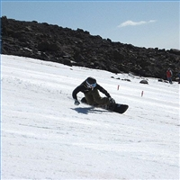

Would this help?
These men are carving.

Slide 72
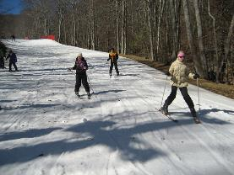
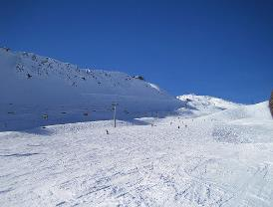
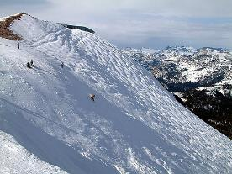
How about this?
Green Slope
Blue Slope
Black Slope

Slide 73
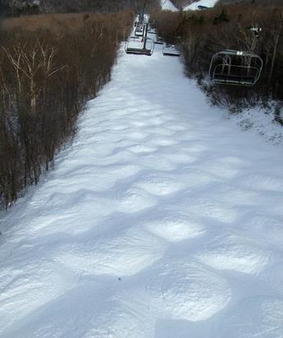
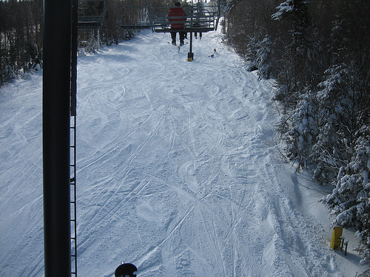
Moguls Packed Powder

Slide 74
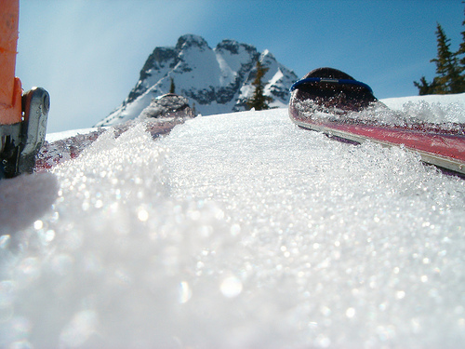
Corn Snow

Slide 75
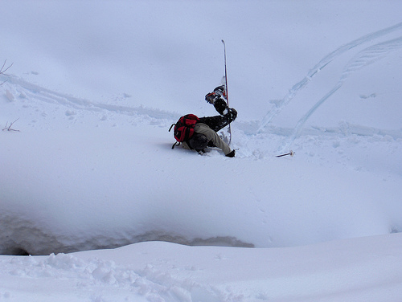
Face-plant

Slide 76
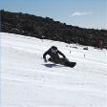








Carving is appropriate for most green and blue slopes
and even some black slopes. However, if you try to carve
through moguls, especially in packed powder or corn snow
you’re going to face-plant.
apropiado
especialmente

Slide 77
Keeping It Together
Sheltered Instruction
ELPS
Content and Language Objectives
Speaking in Complete Sentences
Randomization Techniques
Total Response Signals
Developing Academic Vocabulary

Slide 78
Session Objectives
Content Objective
Language Objective
Today I explored sheltered instruction techniques and strategies to make content comprehensible for my ELLs.
Today I shared different ideas on how to implement sheltered instruction strategies in my classroom.

Slide 79
Tickets Out
I used to think…
But now I know…

Slide 80
Thank you for your participation!
Karina E. Chapa, M.Ed.
Language Proficiency, Biliteracy and Cultural Diversity Director
kchapa@esc1.net
Facebook: Region One ESC Bilingual
Twitter @esc1bilingual @bilingualpride

